Slide 1

Mrs. Smith’s Grade 2
Burton Elementary School

Slide 2


Schedule
7:40-8:00-Transition to School
8:00-Instruction Begins
9:45-Snack
10:05-Recess (20 minutes)
11:35-Lunch
11:55-Lunch Recess (30 minutes)
1:45-Dismissal
Physical Education will be on Mondays, Tuesdays and Wednesdays.
Library will be on Friday’s. Please ensure all Library books are returned on time (every Friday morning if not before).

Slide 3


Supplies
Change of clothes (pants, shirt, underwear, socks-all labeled with name and stored in a plastic bag labeled with name)
Indoor sneakers (preferably Velcro)
Large book bag and lunch box
Water bottle
1 large and 1 small box of Ziploc bags
1 box of tissues
2 community masks
$25.00 for remaining school supplies and a $10 Agenda fee (Please pay both fees via School Cash Online).

Slide 4

Homework
Nightly reading and Sight Word Review will be the only assigned homework for this year.
Reading book(s) and Sight Word Books will be sent home on Mondays and expected back on Fridays.
However, burgundy communication bags, red homework duotangs and agendas will travel back and forth to school each day.
Please check bags and agendas each night.
Should you need to send a note to school, please place it in the plastic sleeve inside your child’s agenda.

Slide 5

Class Websites
We have a Grade Two class website that we will use frequently. Here you will find a variety of resources and links to other websites we also use in class, as well as various academic videos and the curricular outcomes we will be covering throughout the year. You will also find important information on upcoming class events. Please be sure to familiarize yourself with our website using this link: https://burtongradetwo.weebly.com/
Your child will also have their own Raz Kids account for online reading. They will be using this each day at school and are encouraged to also use it at home. Login instructions will be sent home shortly.
Also, please check our School website frequently to stay up to date on all school-related activities: https://secure1.nbed.nb.ca/sites/ASD-W/burton/Pages/default.aspx

Slide 6

Contact Information
School Phone: 357-4074
Email: tanya.smith@nbed.nb.ca
If your matter is time sensitive, (i.e. your child is getting picked up after school instead of taking the bus), please phone the school and Mrs. Morabito will give me the message immediately as I don’t always get a chance to check my email during instructional hours.

Slide 7
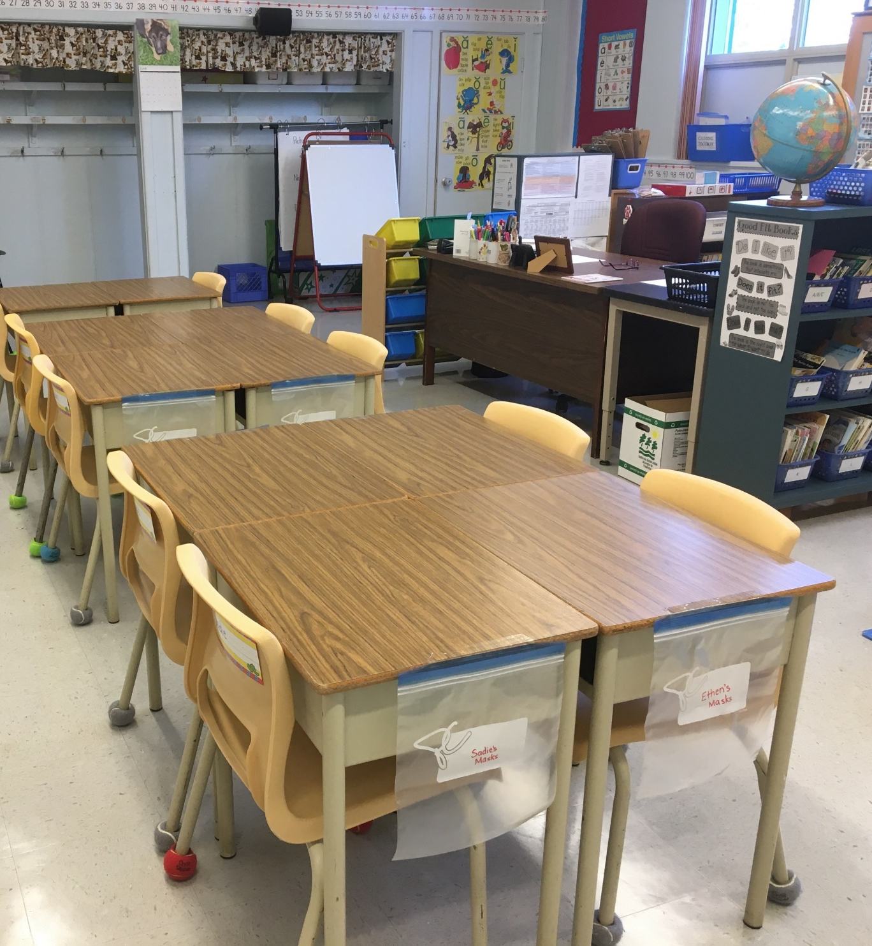
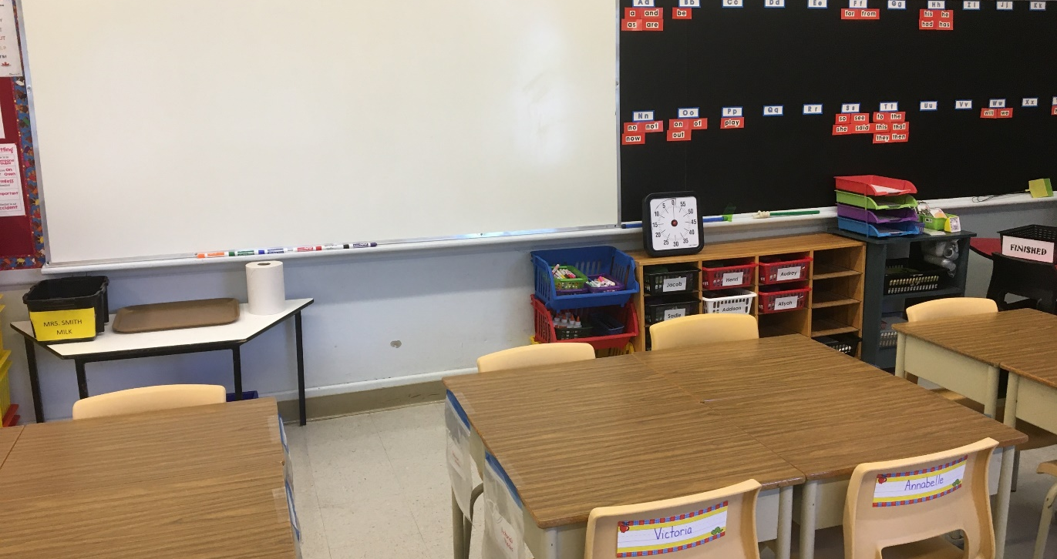
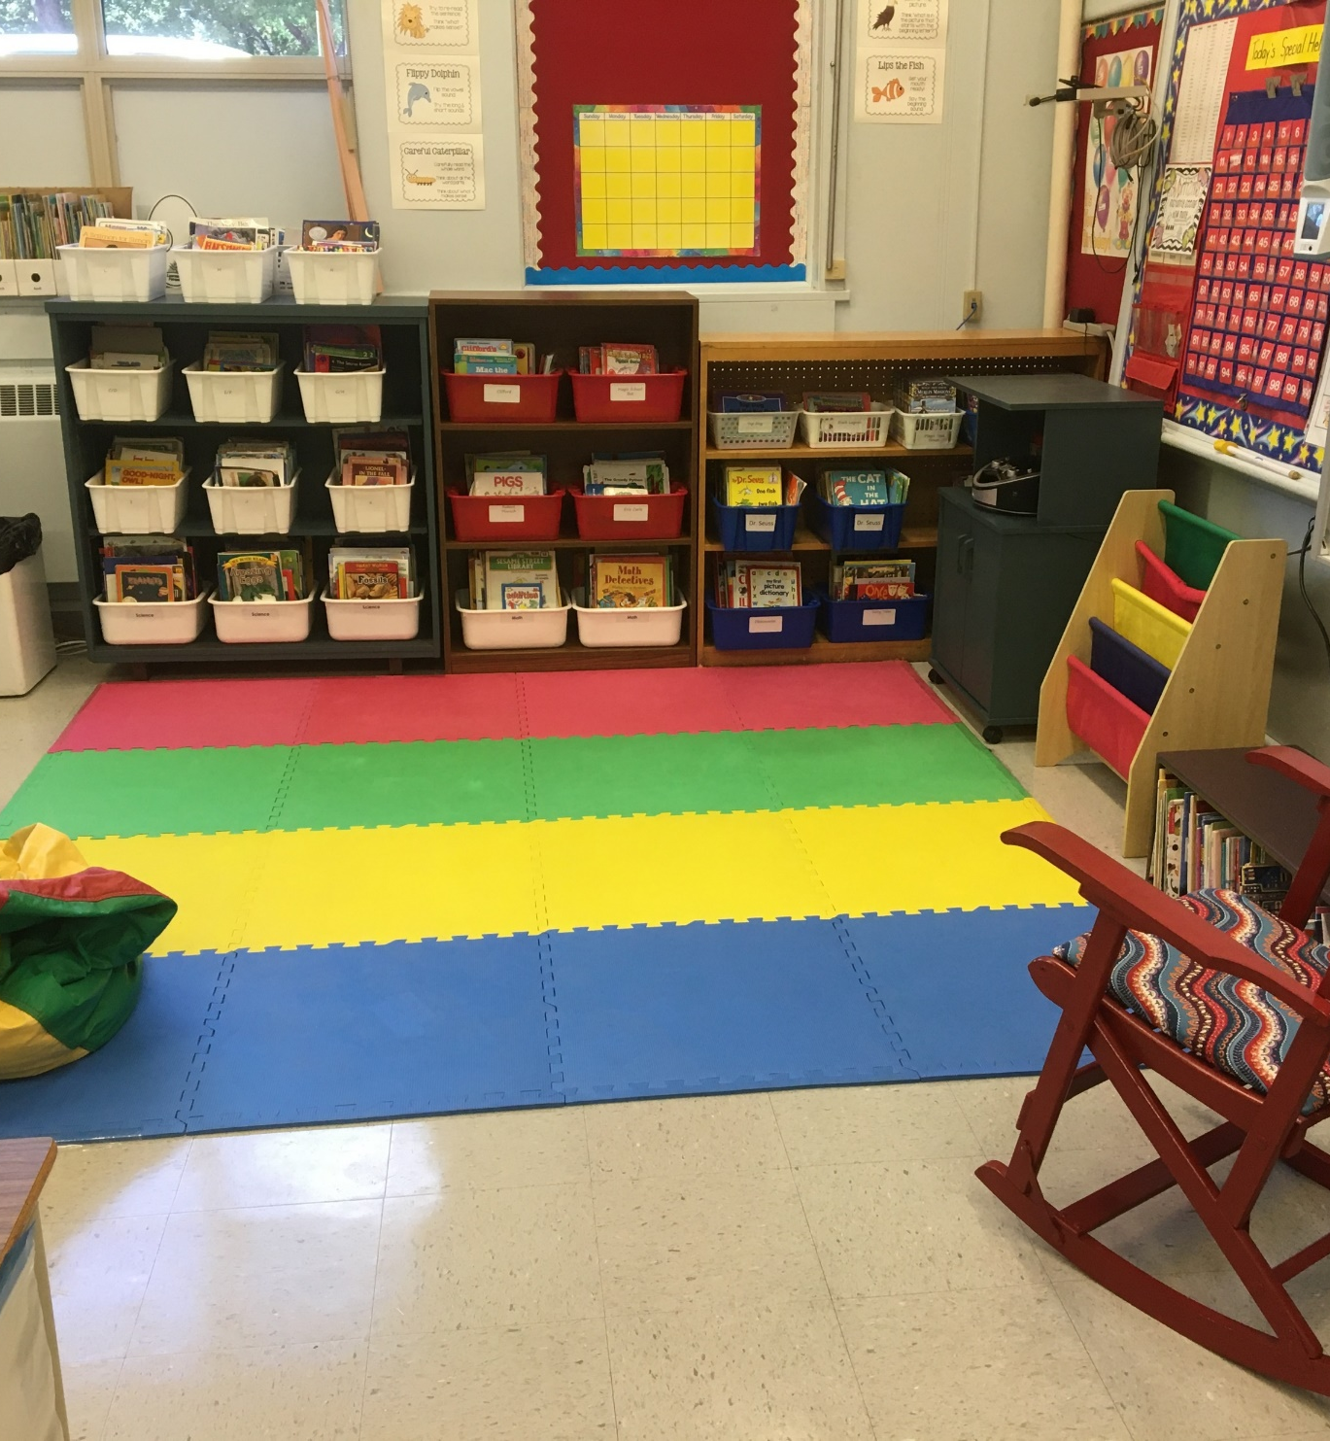
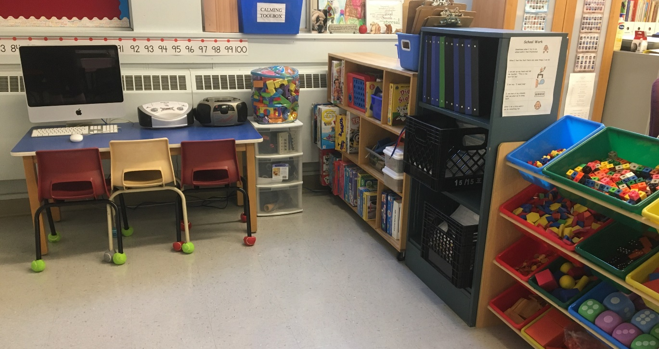
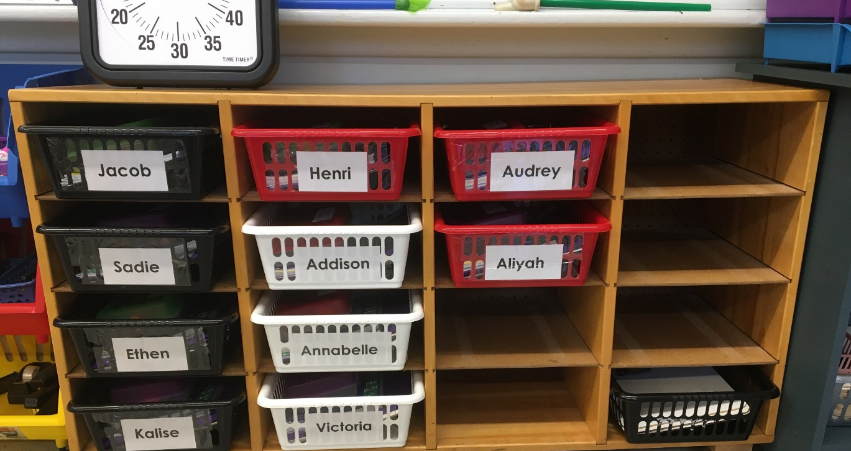
Our Classroom

